Slide 1


Gas Leakage detection and Automatic knob shut off
using Raspberry Pi
GURRAM.ANKIT
20951A0415

Slide 2
ABSTRACT
This paper examines the implementation of a gas leakage detection system with automatic gas knob shut-off capability. The survey explores technologies like wireless sensor networks, IoT integration, and cloud computing for real-time monitoring and timely response to gas leaks. The findings highlight the significance of safety, reliability, and scalability in developing effective gas leakage prevention systems.

Slide 3
KEYWORDS
Raspberry Pi using ADS1x15
MQ-6 Gas Sensor
LCD
LPG
Solenoidal Valve
Stepper Motor Driver
Buzzer
GSM modem

Slide 4
INTRODUCTION
Potential risks associated with gas leaks, such as fire, explosions, and health hazards, necessitate the development of robust gas leakage detection and prevention systems.
Implementation of a gas leakage detection system with an automatic gas knob shut-off mechanism
This system aims to detect gas leaks in a timely manner and take immediate action by automatically turning off the gas supply to prevent accidents and mitigate the potential dangers.

Slide 5
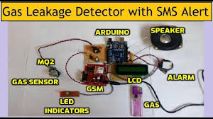
LITERATURE SURVEY

Slide 6
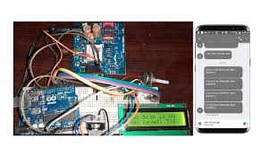
LITERATURE SURVEY

Slide 7
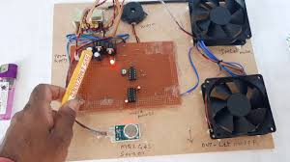
LITERATURE SURVEY

Slide 8
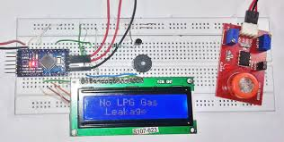
LITERATURE SURVEY

Slide 9
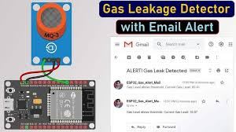
LITERATURE SURVEY

Slide 10
METHODOLOGY USED
A GSM Module the Global System for Mobile/ GPRS (General Packet Radio Service) TTL modems SIM900A (general) quad-band GSM/ GPRS device operates on frequencies that are used to communicate over the mobile network.
The Modem is very small in size and can be used as a plug-in GSM Modem with ease. The Modem is designed with 3V3 and 5V DC TTL interfacing circuitry and can operate.
The main mishap associated with the use of LPG is caused by the dangerous gas spilling out. Gas barrels that are used in every Indian household unit have the potential to develop gas holes.
The gas pipeline is another potential source of gas spillage because ancient pipelines frequently deteriorate and eventually rupture, providing a route for gas leakage. LPG is a flammable gas, thus on the off chance that it leaks, the risk of flame hazards is at its peak

Slide 11
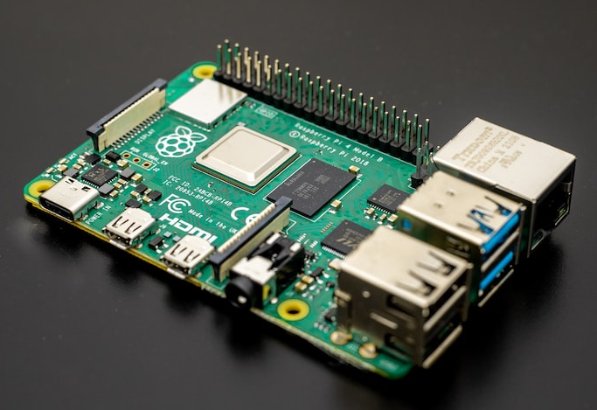
Raspberry pi
Raspberry pi boards are capable of reading inputs from light sensors, detecting changes in the physical environment, and online or offline activating additional modules (motors, publishing anything, or any electrical component). The Raspberry pi software's user-friendly interface makes it convenient for newcomers

Slide 12
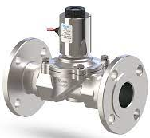
Solenoidal Valve
To manage the flow of any hazardous gas or combustible oil and gas, this machinery is quite safe. It lessens the chance that an outdated rotatory valve would catch fire as a result of any spark that might be generated by a motor or other moving component.

Slide 13
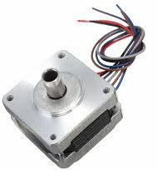
Stepper Motor
Stepper motors are ideal for finely adjusting knobs because they offer exact placement and control. They function in distinct phases, enabling deliberate and progressive motions. It is crucial to check that the motor driver and control system can manage the load and deliver enough torque to turn the gas knob.

Slide 14
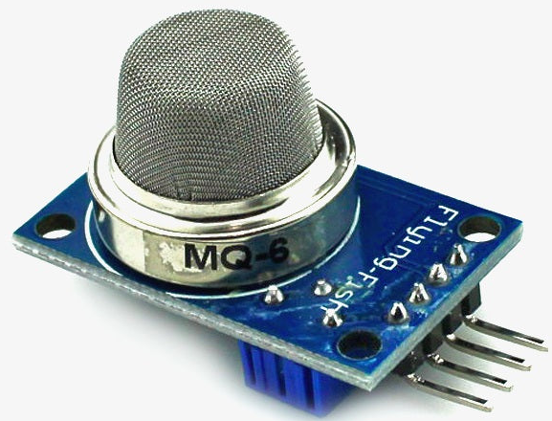
MQ–6 Sensors
It detects the presence of any combustible gases, including LPG. This sensor's detection speed is extremely quick. It lives for a very long time. It offers great sensitivity to isobutane and propane in addition to LPG. It is sensitive to smoke and alcohol. According to the manufacturer's specifications, the sensor's fundamental dimensions are 20 mm in width and 23 mm in height

Slide 15
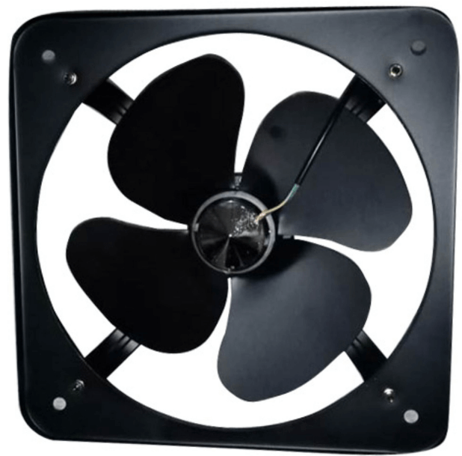
Exhaust Fan
When the gas sensor detects the gas, the exhaust fan is activated. It is used to evacuate the room of gas that has spilled from a particular area.

Slide 16
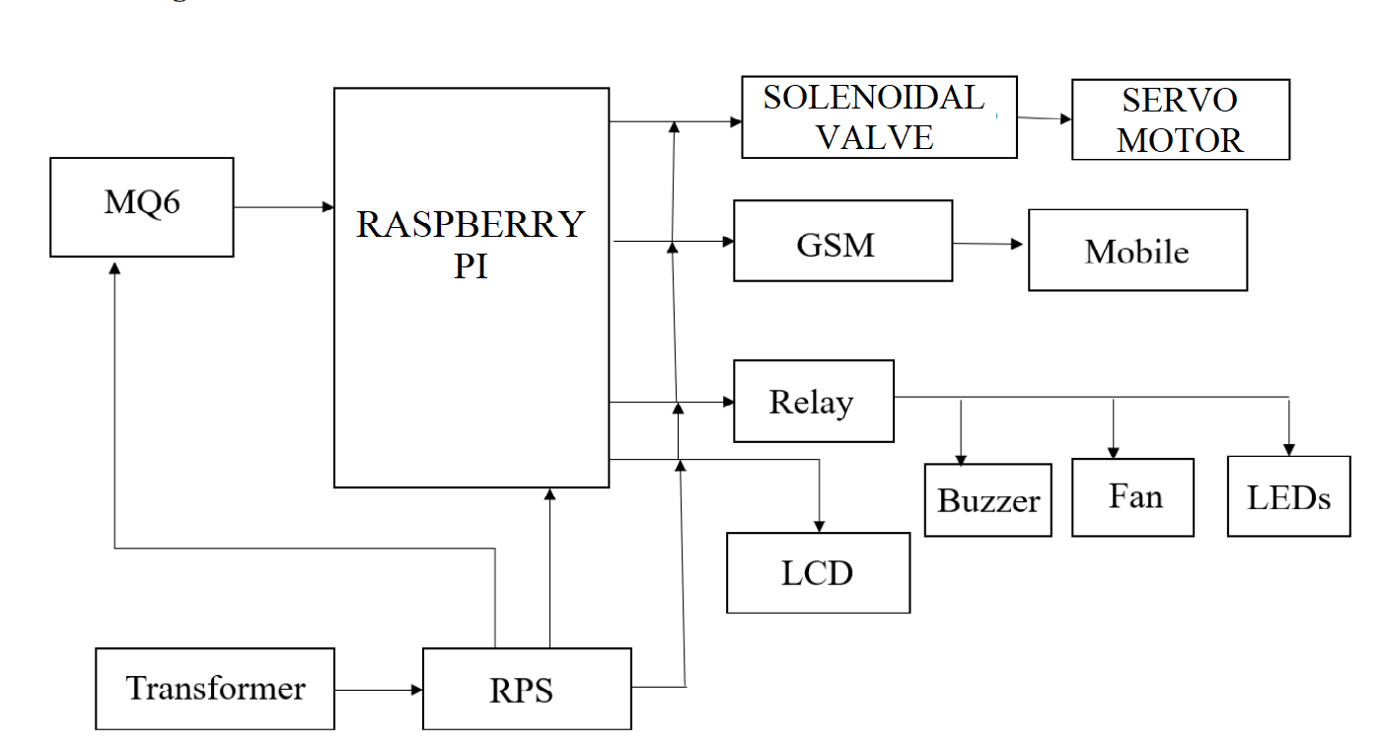
Block Daigram
A GSM Module the Global System for Mobile/ GPRS (General Packet Radio Service) TTL modems SIM900A (general) quad-band GSM/ GPRS device operates on frequencies that are used to communicate over the mobile network. The Modem is very small in size and can be used as a plug-in GSM Modem with ease. The Modem is designed with 3V3 and 5V DC TTL interfacing circuitry and can operate. The main mishap associated with the use of LPG is caused by the dangerous gas spilling out. Gas barrels that are used in every Indian household unit have the potential to develop gas holes. The gas pipeline is another potential source of gas spillage because ancient pipelines frequently deteriorate and eventually rupture, providing a route for gas leakage. LPG is a flammable gas, thus on the off chance that it leaks, the risk of flame hazards is at its peak. LPG From 0.72% of all kitchen accidents to 10.74% of all kitchen mishaps, gas spills have increased.

Slide 17
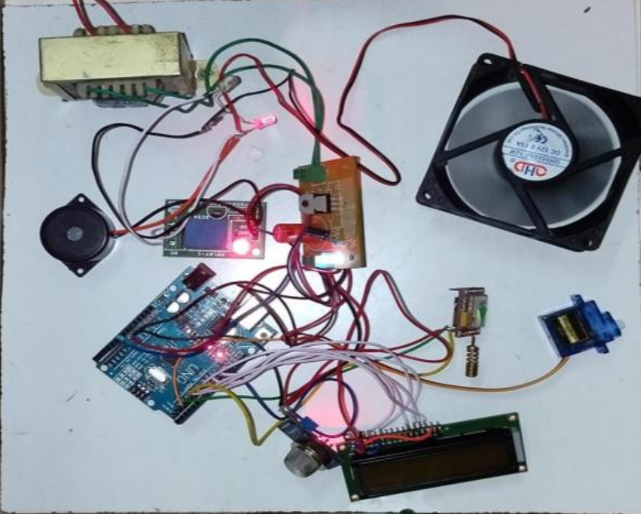
Result and Discussions
The gas sensor may take a few seconds to detect a gas leak, but once it does, it closes the valve right away and then immediately it will have the command to the closing section of the gas knob so the we will have the complete command of security in our hands so that we can save the people.

Slide 18
Conclusion
The system can be implemented to recognise various spillages gases at residential, lodging, dining, and other commercial and industrial areas to prevent endangering human live

Slide 19
THANK YOU

